Slide 1

Introduction to Optimization (1)
Professor Bo Liu
James Watt School of Engineering

Slide 2
What is optimization?
Find the best plan or design
Optimization/Search Problem
Conventional optimization methods
AI-based heuristic methods
Advantages: In many cases, stronger ability, easier to use

Slide 3
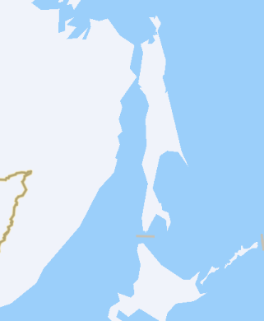
Popular optimization problems: TSP
Traveling Salesman Problem (TSP)
A salesman needs to go to several cities to sell commodities.
How to select the travel route to minimize the total travel distance?
In what order should the salesman visit these cities to minimize the distance traveled (cost)?
1
2
3
4

Slide 4
Popular optimization problems: TSP formulation
Formulation of TSP
Representation of a tour? Permutation
  e.g.: 4 cities: (1, 4, 3, 2) means: 1→ 4 → 3 → 2 → 1
  Generally, p={p(1), p(2) , …, p(n), p(1) }means:
  p(1)→ p(2) → …→ p(n) → p(1)
  where p(n) is the n-th city to visit
The length of tour (Objective function)
$$L(p)=d_{p(1),p(2)}+d_{p(2),p(3)}+⋯+d_{p(n−1),p(n)}+d_{p(n),p(1)}$$

Slide 5
Popular optimization problems: key concepts
TSP is defined as:
Look for a permutation vector in to minimize
Formulation of TSP
Objective (Cost) function
Minimize
Search space
Decision variables

Slide 6
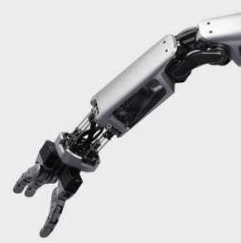
Application of TSP
Applications of TSP
Robot control
Which order should the robotic arm be used to minimize the drilling time?
An embedded system containing the optimization algorithm.
Robot arm

Slide 7
Popular optimization problems: QAP
Quadratic Assignment Problem (QAP)
Assign n Depts to n Sites
Given: distances between sites
material flow between departments
Goal: Minimize the cost of transporting
( sum of flow x distance)
Which sites should Dept 1,2,3 go to?
Site 3
Dept 1
Site 1
2
4
1
5
6
?
2
Dept 2
Dept 3
Site 2

Slide 8
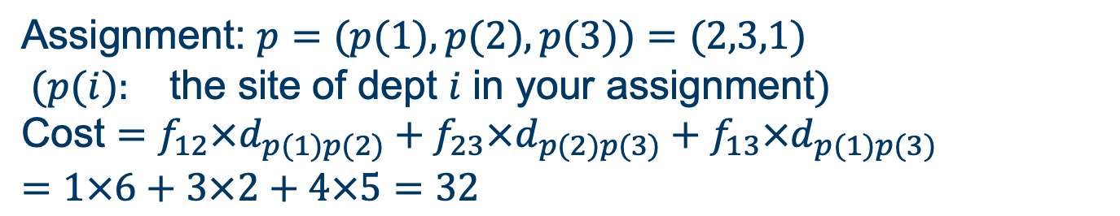
Popular optimization problems: QAP formulation
Formulation of QAP
$$\text{Distance} \text{between} \text{the} \text{sites}\text{: }d_{12}=5 d_{23}=6 d_{13}=2 \\ \text{Material} \text{flow} \text{between} \text{the} \text{depts}\text{: }f_{12}=1 f_{13}=4 f_{23}=3$$
$$\text{Assignment}\text{: }p=(p(1),p(2),p(3))=(2,3,1) \\ (p(i): \text{the} \text{site} \text{of} \text{dept} i \text{in} \text{your} \text{assignment}) \\ \text{Cost}=f_{12}×d_{p(1)p(2)}+f_{23}×d_{p(2)p(3)}+f_{13}×d_{p(1)p(3)}=1×6+3×2+4×5=32$$

Slide 9
Combinatorial optimization problems
Combinatorial optimization problems: ​
  TSP: 1 4 5 3 2 1
  QAP: 2 3 1
  The set of feasible solutions is discrete (natural number) or can be reduced to a discrete set.

Slide 10




Thanks!
#UofGWorldChangers
@UofGlasgow

